Slide 1
Technical English
for English Language Learners
Hamid Khattak
HCT

Slide 2
"Turn off motor before using this product."

Slide 3
For laminar flow of liquids, the coefficient K used to calculate
energy loss due to sudden enlargements is given by
where R is the ratio of cross-sectional areas.
If K = 0.500, what is the value of R?

Slide 4
For laminar flow of liquids, the coefficient K used to calculate
energy loss due to sudden enlargements is given by
where R is the ratio of cross-sectional areas.
If K = 0.500, what is the value of R?

Slide 5
Children (7-12 years): Half to one tablet
Only half (54%) of the people were correct
Of the English-speaking born, 55% were correct
Of the Non-English speaking,
52% were correct

Slide 6
memory (remembering more effectively): e.g. “I think of relationships between what I already know and new things I learn in English.”
cognitive (using all your mental processes): e.g. “I try to find patterns in English.”
compensation (compensating for missing knowledge): e.g. “If I can’t think of an English word, I use a word or phrase that means the same thing.”
metacognitive (organizing and evaluating learning): e.g. “I think about my progress in learning English.”
affective (managing emotions): e.g. “I encourage myself to speak English even when I am afraid of making a mistake.”
social (learning with others): e.g. “I ask for help from English speakers.”

Slide 7
Low-use students said that because they did not need English they would not benefit from thinking about their progress, reading outside class, or learning another culture.
High-use students, however, believed that it was important to pay attention when someone was speaking and to read English for pleasure.

Slide 8
Sample Text: Physics Textbook
What length of guy wire is needed to stretch from the top of a
12 m telephone pole to a ground stake located 8 m from the foot
of the pole?
Newton’s Second Law of Motion
Whenever an unbalanced force acts on a body, it produces in the direction
of the force an acceleration that is directly proportional to the force and inversely
proportional to the mass of the body.

Slide 9
Selected words from Page 89
…tension or stress…
…tension exceeds… …sustains a maximum tension…
…cable sags…
…the ends of three 8-ft studs are nailed together, forming a tripod with an apex…
…inclined wooden plane…
…drag the sled…
Cord, cable or wire?

Slide 10
Personal Experiences
Do we
make electricity or generate/produce electricity?
give voltage or supply voltage?
generate or produce light?
Plant as a tree or like a chemical plant.

Slide 11
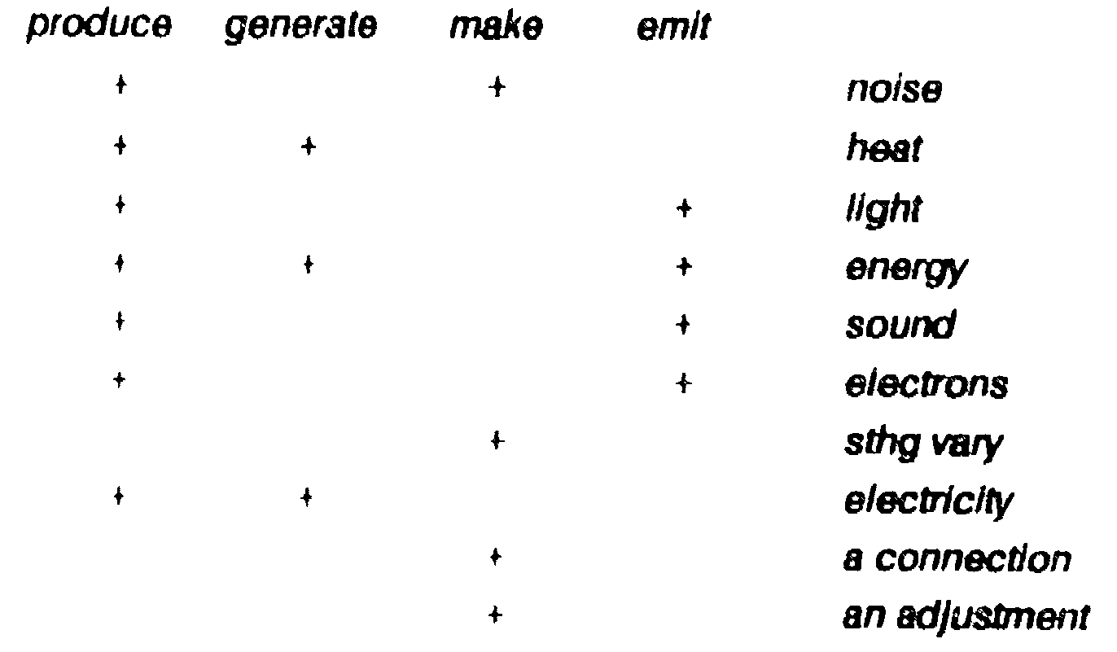
Collocational Exercise on produce/generate/make/emit
Farrell, P. (1989). Vocabulary in ESP: A Lexical Analysis of the English of Electronics
and a Study of Semi-Technical Vocabulary. Trinity College; Dublin.

Slide 12
General Words List
Close | 6 times as an adjective (near) | 9 times as a verb (shut)
Make | 14 times in the sense ‘to build’ | 7 times as ‘to cause something to happen’
Above | 4 times as ‘more than once’ | 10 times denoting spatial relations
Notes:
Shut down my computer or close down?

Slide 13
Semi-Technical Words List
Common | 5 times meaning ‘usual’ | 18 times as e.g. common base
Unit | 7 times as a number of tools or equipment | 24 times as a unit of measurement
Form | 8 times as ‘shape’ | 11 times as ‘to create’

Slide 14
Technical Words List
Force | 3 times as ‘strength, power, impetus …’ | 27 times as ‘any influence that can cause a body to be accelerated’
Current | 2 times as flow of water | 31 times as flow of electrons
Form | 8 times as ‘shape’ | 11 times as ‘to create’

Slide 15
What research has found is that if we ask students to only rely on knowing that certain key words signal specific operations, we can actually lead them away from trying to understand the problems.
They will tend to look only for those words and whatever numbers are in the problem, even if they are not relevant to the answer. This will not help them become proficient in engineering subjects later, even when they are proficient with English.

Slide 16
Technical English and
English Teachers
Teachers teaching technical English should be familiar with terminologies relevant to engineering.
If the general and technical senses of an item are clearly related, or polysemous, this may be of assistance to English language learners.
English teacher could play a role in bringing out the connection between general and technical meanings.

Slide 17
For example,
Capacitor may be explained by its “capacity” to store electricity.
The general meaning of the word resist may be linked to its
technical sense of obstructing, or slowing a flow of electricity.

Slide 18
Instruction that emphasizes language activities should be incorporated into content area lessons and curricula.
This requires
development in teacher training,
curricula and materials,
assessment, and
cooperation between content and language educators.

Slide 19
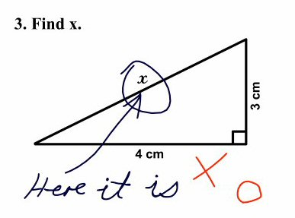

Slide 20
TEP (Technical English Programs)
IEEE
IEEE TEP Pilot Projects were implemented in St Petersburg, Russia, and Uruguay for the IEEE student members.
http://www.ieee.org/web/education/technical_english/index.xml
IEEE Technical English Program - United Arab Emirates March 2010

Slide 21
The Big Question
How can engineering lecturers ensure that appropriate literacy issues are addressed?

Slide 22
The future success of engineering education and engineering
profession rests on embracing liberal education. It rests on
developing the leaders of the society. The leaders of the suture
must be skilled in art of communication. Engineers are
responsible for educating our society on the technology of
the future.

Slide 23
Woe to the makers of literal translations,
who by rendering every word weaken the meaning!
It is indeed
by so doing that we can say the
letter kills and the spirit gives life.
Voltaire, in Lettres Philosophiques, 1734

