Slide 1
Engineering/Technology Curriculum Development for High School
Engineering/Technology Curriculum Development for High School: An Electrical Engineering Perspective
Engineering/Technology Curriculum Development for High School: An Electrical Engineering Perspective

Slide 2
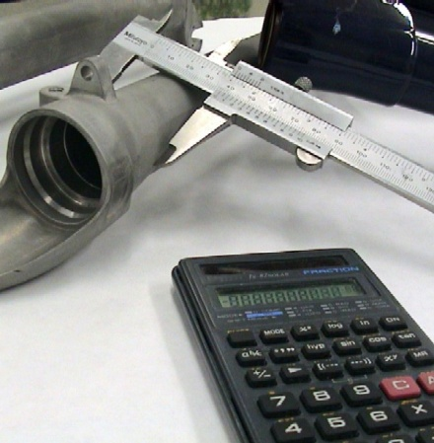
Presentation Outline
Introduction
Current Status
Reasons
Change and Motivation
Proposal for change
Conclusion
Future outlook

Slide 3
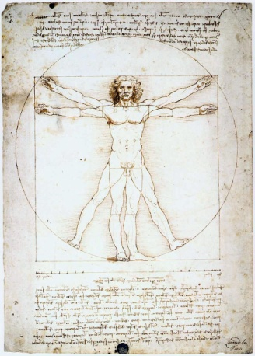
Introduction
“ Engineering is the profession in which a knowledge of the mathematical and natural sciences gained by study, experience, and practice is applied with judgment to develop ways to utilize, economically, the materials and forces of nature for the benefit of mankind ”
Accreditation Board for Engineering and Technology
Study
Experience
Practice

Slide 4
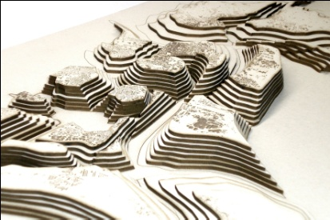
Current Status
Recent Technology Development
Increase of Science & Technology job market
Global decline of engineering students
Level of students in Math & Science
Quality engineers
Problem-solving skills
Critical thinking
Innovators,
Inventors

Slide 5
Current Status – Engineering Graduates
Low Engineering Graduates
Low Female Engineering Graduates
UNESCO
http://stats.uis.unesco.org/unesco/TableViewer/tableView.aspx

Slide 6
Current Status – HCT Eng. enrollment
Slow increase in HCT Engineering Enrollment compared to business

Slide 7
Current Status – Female Graduates
HCT Engineering Female Graduates

Slide 8
Conjectured Reasons
High school preparation in Math and Physics
Lack of exposure to engineering
Lack of understanding of what engineers do.
Lack of understanding of the impact of engineering on society
Unaware of career opportunities in engineering
Engineers are rarely represented in TV shows or movies (exception: Ben Affleck in Paycheck)!

Slide 9
The Change ?
Will the introduction of Engineering and Technology principles and applications at an early stage e.g. secondary school help change the current status?

Slide 10
The Outreach Initiative
Outreach Engineering Program
Assess students’ interest, attitude performance before & after.
higher education institutions
schools
industry
Partnership

Slide 11
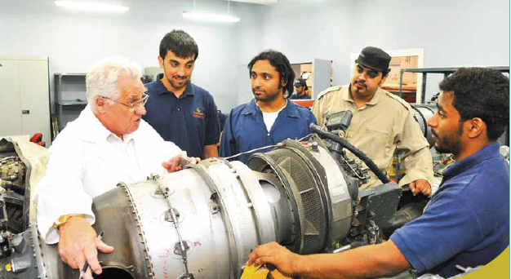
Outreach Program Young Emirati Engineer (YEE)
To attract, motivate, stimulate, and educate young students to become engineers
Introduce engineering and technology principles and applications to secondary school classrooms.
Prepare students for the challenges of a high tech society.
Improve math and science education and align secondary school education systems to engineering education
Attract girls to engineering

Slide 12
Outreach Program
Science
(Physics)
Math
Quality Engineer
English
Engineering
Technology

Slide 13
Existing Outreach Programs?
UAE – Masdar University
Launched in Dec 2009
Focuses on Energy
USA
Project Lead The Way (PLTW) focuses on in Science, Technology, Engineering, and Mathematics (STEM) for high school.

Slide 14
Elements of the Outreach program
Outreach program
Curriculum
Technologies
Partners
Teachers
Students

Slide 15
Outreach program Curriculum Design
Curriculum
Expectations
Skills of research & inquiry
Society and environment
Communication skills
Reports, graphs tables, equations
English
Technologies
Health & safety

Slide 16
Outreach program Curriculum Characteristics
Project Based learning
Interactive engineering
Hands on inquiry
Rigorous, Relevant
Demo Classes
Practical exercises,
Teachable by high school students

Slide 17
Outreach program - Curriculum
Engineers are Problem Solvers
Emphasis on Scientific Investigation, Enquiry & Critical Thinking
Researching
Formulating questions
Analyzing
Communication skills

Slide 18
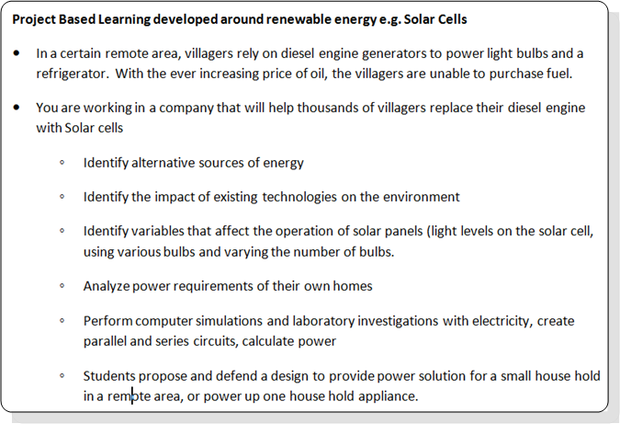
Outreach program - Curriculum
Story Line
Problem
Society & Environment
Research
Analysis
Communication
Design

Slide 19
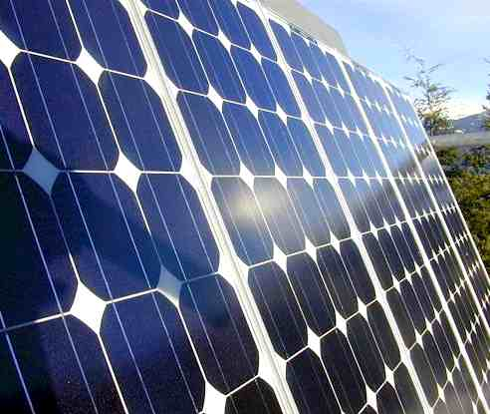
Outreach program - Curriculum
Developing the scientific attitude of Inquiry and critical thinking
Project management, Practical experience, Researching
Formulating questions
Analysis
Design Skills Team work, Comm. skills

Slide 20
Outreach program
Teachers
Students
Partners
Train teachers
Engage Teachers
Support teachers
Motivate students with interest
Attract undecided students
Resource for schools & students
Visits
Motivational talks

Slide 21
Conclusion
Introduce Engineering to High School
Suggested Outreach Program
Focus on Project Based learning
Young Emirati Engineer

Slide 22
Future Outlook
Adopt Engineering Curriculum in High Schools

